Slide 1

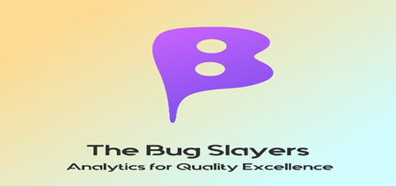

TEAM NAME:
BUG SLAYERS

Slide 2
Problem Statement
Multiple parallel releases for priority projects and products with faster turn around and go to market.
QA and Product teams unable to focus on the right areas of defect detection & regression testing.
Defects causes time loss, losses ($$) , impact credibility & invite penalties
Retrospective meetings for defect prevention with stakeholders takes a lot of time & effort.
Tech Problem Statement
To identify hotspots within the application
identify defect patterns to give list of defects & solutions already occurred in past similar
Predict Defect based on estimates given by team for upcoming releases

Slide 3
Describe your solution
A ML modelling solution to identify functionality hotspots in the application and classify the new defects automatically
NLP predictive analysis for top defects matching the defect description pattern of the newly raised production defects
Number of Defects prediction using regression ML technique
Technology Stack used
Watson Studio
Watson Machine Learning
Natural Language Processing
DB2
Cognos Dashboard
Cloud Foundry App (flask, python)

Slide 4
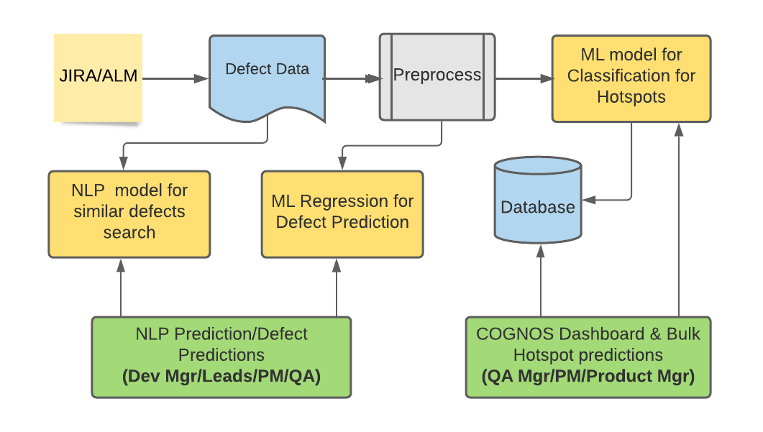
Describe your solution

Slide 5
Use Cases & Business Value of the solution
Use Case | Solution | Business Value
To identify defect hotspots within the application | Hot Spot and Defect Dashboard for QA Manager, Project Manager, Product owners | Able to get automated insights on historical
Predict Defect based on estimates given by team for upcoming releases | Defect Prediction UI for Developers | Developer community can be assisted with the predictions on defects; so that they can prepare with better estimations and team expertise for upcoming requirements
Identify defect patterns to give list of defects & solutions already occurred in past similar | NLP for closets matching historical defects and implemented resolution | Developer community can do quick search for historical defects and can see past solutions implemented for new production defects

Slide 6

What was accomplished
 | Hotspots | Defect Patterns | Defects Forecast
Models Used | Classifier | NLP | Regression
Main features | Defect Density Severity Functionality Complexity Business Impact | Defect description | Complexity Points (size of software) Complexity factor Team Expertise
Predictions
Bulk Predictions
UI/Dashboard

Slide 7
Challenges & Learnings
Environment Challenges for Watson Service availability and API
Lite account limitations for CUH hours consumed
Usability and different syntax for DB2
API Integration challenges e.g. Integration of WML API with
Learnings
DB syntax different for cloud DB2
Model Deployment and API integration for models

Slide 8
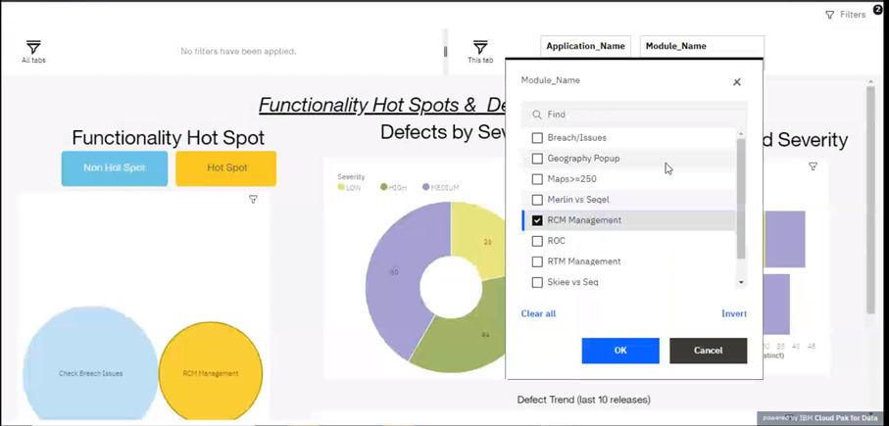
Screenshots (Functionality Hotspot Dashboard -1)

Slide 9
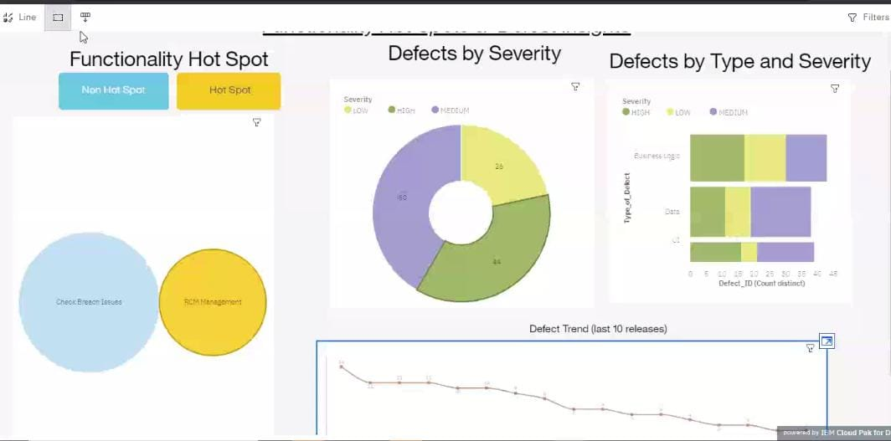
Screenshots (Functionality Hotspot Dashboard -2)

Slide 10
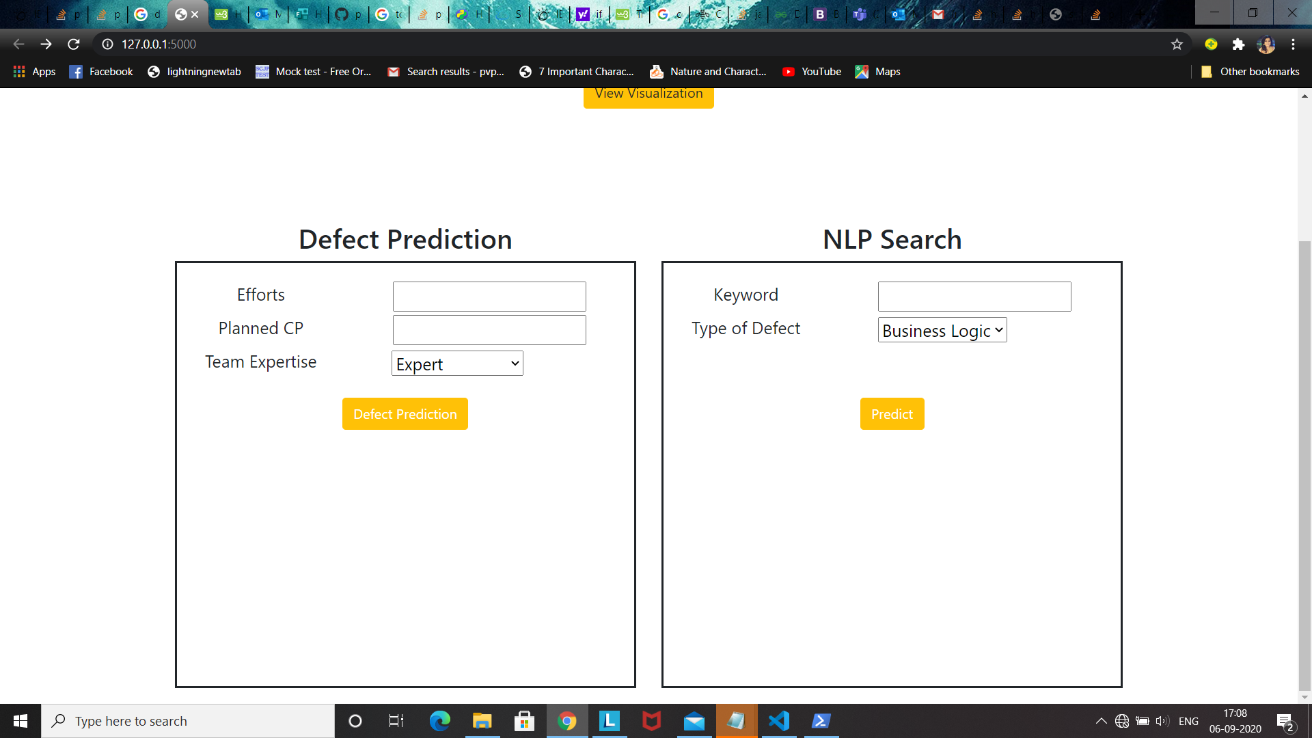
Screenshots (App Home Page)

